Slide 1

BUS7C1 CORPORATE STRATEGY AND INTERNATIONAL MANAGEMENT
Lecture 1 Introduction

Slide 2

Corporate Strategy and International Business
Lecture1
> Introduction to the module
> Introduction to the Business Strategy
Elan Kandaswamy – Module Leader
Elan.kandaswamy@wrexham.ac.uk

Slide 3
By the end of today you will…
Be familiar with the module content and aims
Be familiar with the assessments associated with the module
Be familiar with the meaning of Strategy

Slide 4
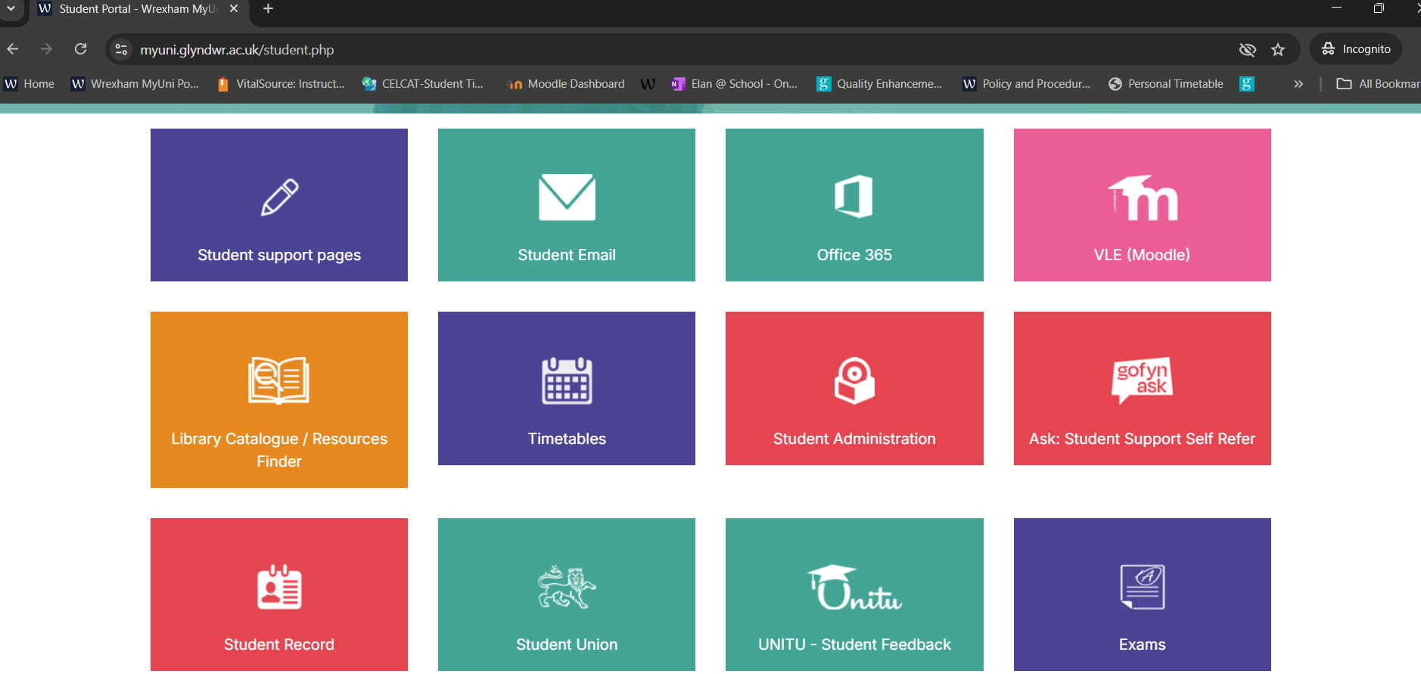
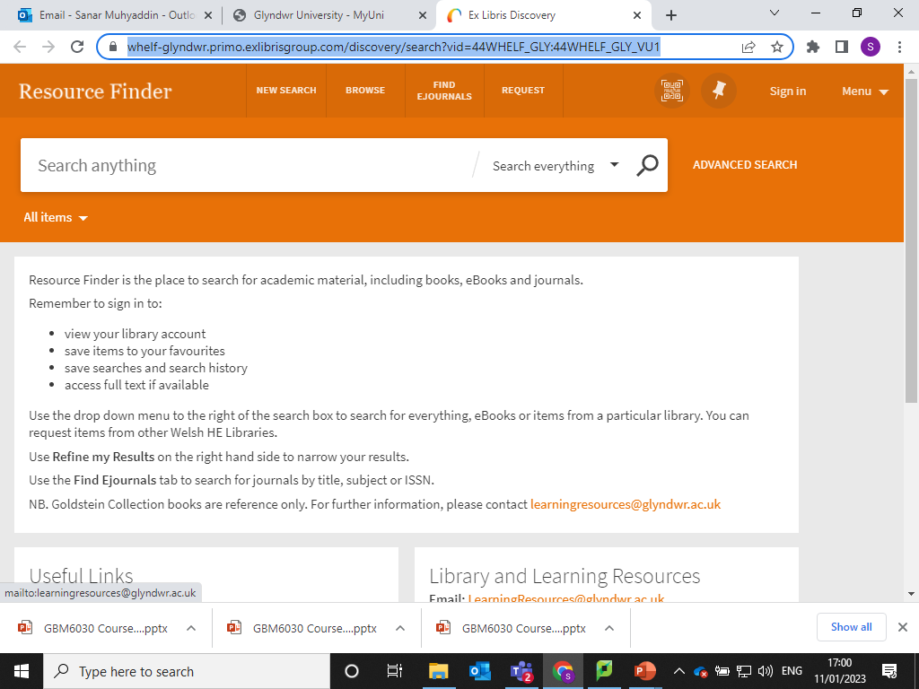

How to find the books, Journals and News Articles? ‘Resource Finder’
Step 1: Myuniportal link: https://myuni.glyndwr.ac.uk/student.php
Step 2: Resource Finder link: https://whelf-glyndwr.primo.exlibrisgroup.com/discovery/search?vid=44WHELF_GLY:44WHELF_GLY_VU1

Slide 5
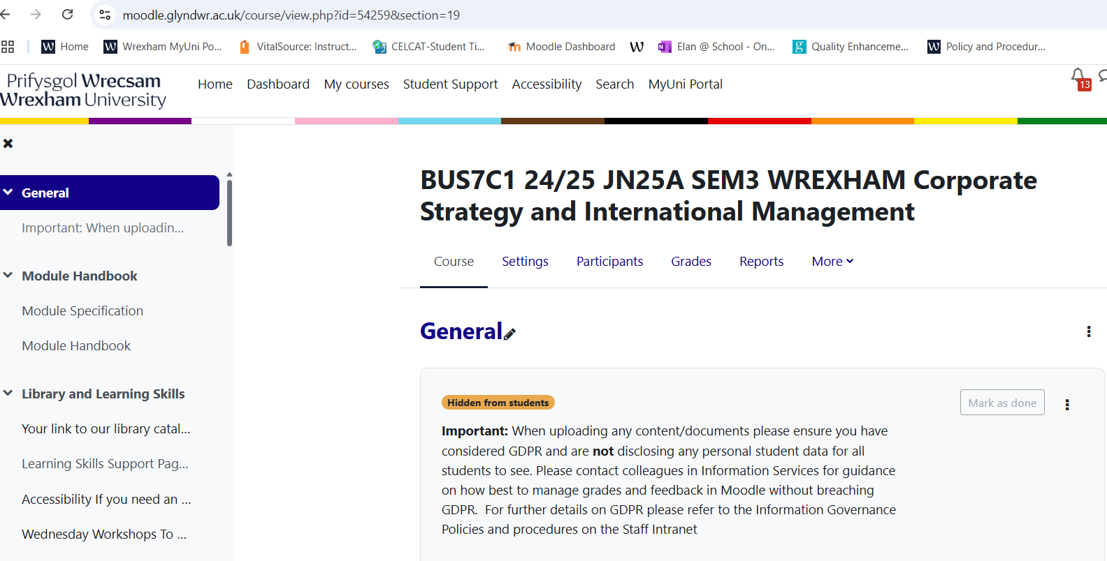

Step 1: Myuniportal link: https://myuni.glyndwr.ac.uk/student.php
VLE (Moodle)
Step 2: How to navigate Moodle (Lib Guide): https://wrexham.libguides.com/moodle/logon
BUS7C1 24/25 JN25A SEM3 WREXHAM Corporate Strategy and International Management:
https://moodle.glyndwr.ac.uk/course/view.php?id=54259&section=19

Slide 6
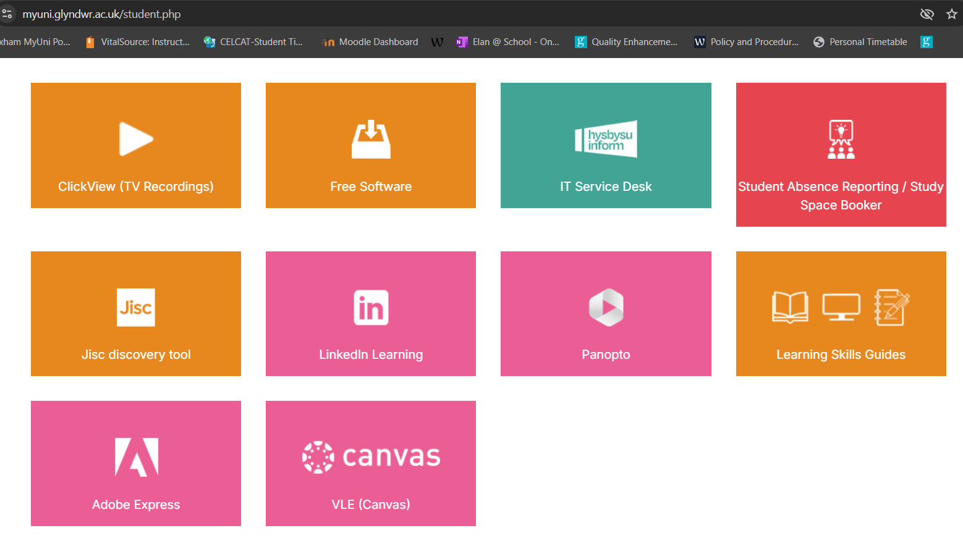
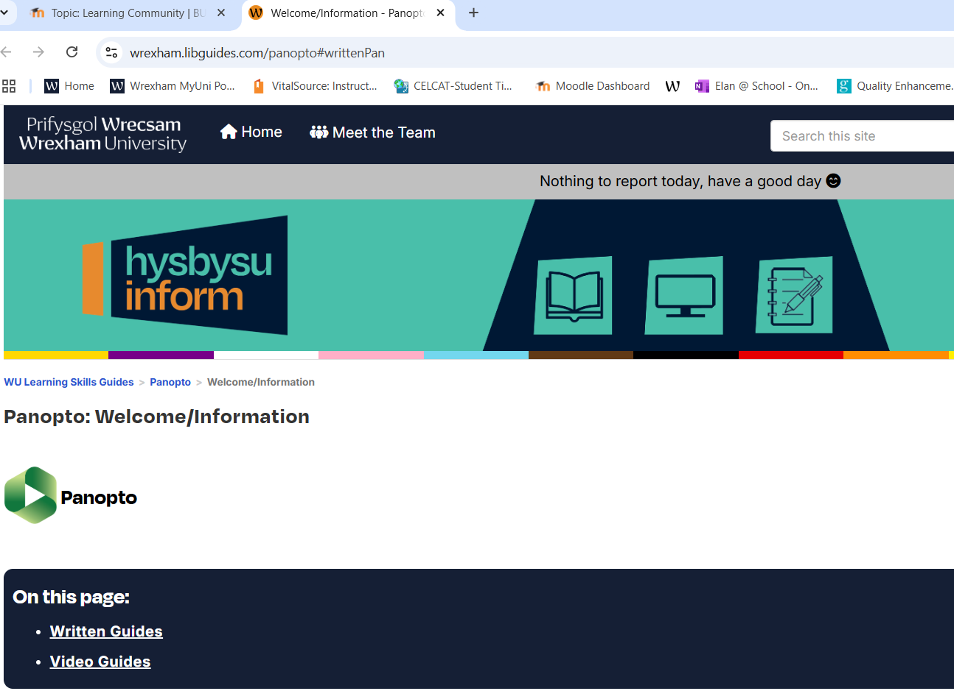
Step 1: Myuniportal link: https://myuni.glyndwr.ac.uk/student.php
Panopto (Video recording)
Panopto guide: https://wrexham.libguides.com/panopto#writtenPan
Assessment and Feedback in Moodle for submission points: https://moodle.glyndwr.ac.uk/course/view.php?id=54259&section=4

Slide 7
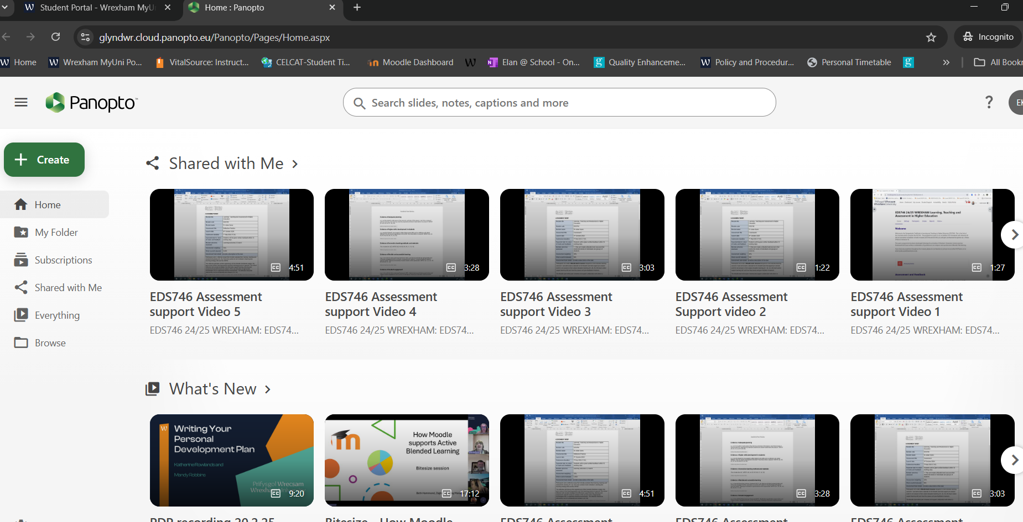
Panopto (Video recording)
Recorded Panopto videos examples: https://glyndwr.cloud.panopto.eu/Panopto/Pages/Home.aspx

Slide 8
Module Aims
The module will provide insights into the factors influencing the formulation and implementation of the strategy within a business environment. The module will consider internal and external factors that impact and influence strategy and leadership and how this translates to management and operations.
The module also aims to facilitate the understanding of issues arising out of the process of internationalisation as well as ethical trading and corporate social responsibility. By the conclusion of the module, students will be able to take these into account when recommending strategies appropriate for a variety of circumstances.

Slide 9
Course Structure
The module is delivered through face-to-face lecture(s) and seminars.
During lectures, theoretical part of the module will be delivered, and during seminars you will engage in discussions and pre-set exercises and case studies.
Ensure you read the Handbook

Slide 10
Learning Outcomes (LO) Assessed
LO1. Critically analyse and apply relevant international business theories and models within an international context.
LO2. Critically appraise strategic and operational decision-making processes within a relevant business context and their complexity within the wider international business environment.
LO3. Critically evaluate corporate challenges that impact on the strategic business environment across national and global business landscapes and provide frameworks and solutions for implementation at management and operational level.
LO4. Critically appraise global practices and their impact on individuals and the organisation.

Slide 11
One company to choose from the list of five for assignment tasks
This is an individual assignment. Ensure that you choose one organisation for the portfolio from the five below and submit this as one word document on Turnitin apart from the news report which will need to be submitted on a different link.
Village Bakery
Money Penny
Marks and Spenser’s
Toyota
Subway

Slide 12
Your Portfolio Assignment (4000 words)
Submission deadline: 9th September 2025, Tuesday, @ 16:30 UK time
Task 1
Written Report
(1500 words)
(LO1 & LO4)
Weighting: 40%
Task 2
Excel Spreadsheet*
(1000 words appx.)
(LO2)
Weighting: 25%
Task 3
Recorded News Report Script
(1000 words appx.)
(LO3)
Weighting: 25%
Task 4
Justification
(500 words)
(LO1-4)
Weighting: 10%
Task 3
Recorded News Report
(10 minutes)
(LO3)
Weighting: 25%
+
+
+
+
Tutorial 1
Tutorial 2
Tutorial 3
Tutorial 4
Tutorial 3
Part 2:
Panopto Video uploaded using the separate link provided on the Moodle
Part 1:
In one file MS Word format (not pdf) to be uploaded on Moodle using the link provided
Note for Task 2 Excel Spreadsheet: * ‘Implementation Plan for Strategic and Operational Decisions’

Slide 13
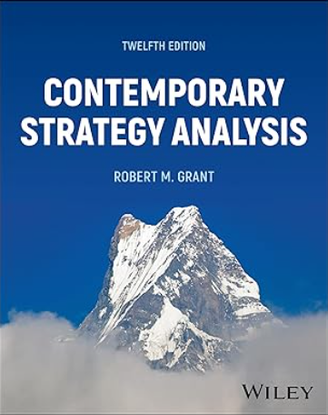
Reading and Preparation
Recommended textbook:
Contemporary Strategy Analysis by Robert M Grant R (2024)
Reference:
Grant, R.M. (2024), Contemporary strategy analysis. New York: John Wiley & Sons Inc.

Slide 14
Any Questions?

Slide 15
The Word of strategy
Greek word- ‘Strategia’ from the compounds ‘Stratos’ meaning Army and ‘Agein’ meaning ‘ to lead.
Ancient Greeks - Siege warfare - Peloponnesian war (c. 460 to 446 and from 431 to 404 BCE)
‘Sun-Tzu (544 – 496 BC) - The Art of War ‘’the supreme art of war is to subdue the enemy with out fighting ‘’- Sun Tzu (500 BCE)
Machiavelli (3 May 1469 – 21 June 1527) - Policy follows power
Clausewitz (1 July 1780 – 16 November 1831 ) - The role of the ‘passions’ in strategy

Slide 16
What is Strategy ?
"Strategy is the direction and scope of an organisation over the long-term: which achieves advantage for the organisation through its configuration of resources within a challenging environment, to meet the needs of markets and to fulfil stakeholder expectations".

Slide 17
Definitions of strategy
‘..the determination of the long-run goals and objectives of an enterprise and the adoption of courses of action and the allocation of resource necessary for carrying out these goals’
Alfred D. Chandler
‘Competitive strategy is about being different. It means deliberately choosing a different set of activities to deliver a unique mix of value’
Michael Porter
Sources: A.D. Chandler, Strategy and Structure: Chapters in the History of American Enterprise, MIT Press, 1963, p. 13 M.E. Porter, What is strategy?, Harvard Business Review, 1996, November–December, p. 60

Slide 18
Definitions of strategy
‘..a pattern in a stream of decisions’
Henry Mintzberg
‘..the long-term direction of an organisation’
Exploring Strategy
Sources: H. Mintzberg, Tracking Strategy: Towards a General Theory, Oxford University Press, 2007, p. 3

Slide 19
Definition of strategy
Distinguishing strategy from tactics:
Strategy is the overall plan for deploying resources to establish a favorable position.
Tactic is a scheme for a specific maneuver
Characteristics of strategic decisions:
Important.
Involve a significant commitment of resources.
Not easily reversible

Slide 20
What Makes a Successful Strategy?
Successful strategy
EFFECTIVE IMPLEMENTATION
Long-term, simple and agreed objectives
Objective appraisal of resources
Profound understanding of the competitive environment
Copyright © 2022 John Wiley & Sons, Inc.

Slide 21
Why do Strategies fail?
What are the main reasons that strategies fail?
Joan Fitzpatrick, Executive Director for Bevington Group in the event of International Institute of Directors & Managers (IIDM)
https://www.youtube.com/watch?v=MQFfCloeAA0
CDS Sound Bite: Why do so many strategies fail when it comes time to execute?
Former PwC (PricewaterhouseCoopers)
Cesare Mainardi, CEO of PwC's Strategy &, and
Paul Leinwand, Managing Director, Strategy &
https://www.youtube.com/watch?v=spsHgWnTGz4

Slide 22
Why do Strategies fail? What is your view?
Please discuss this with the person next to you
You have 2 minutes and then we will discuss as a class

Slide 23
Limits & restrictions of strategy
Complexity – increasing change, no longer simplistic or, seemingly, trivial
Contradictory interests – differing demands from coalitions of multiple and potentially diverse priorities and expectations
Surprises – chance, luck, formal disorder, preparedness, alertness, flexibility, courage and assiduity, serendipitous

Slide 24
Applications of strategy in different contexts
In each context the balance of strategic issues differs:
Small businesses (e.g. strategic purpose, growth issues and retaining independence).
Multinational corporations (e.g. geographical scope; cultural issues and structure/control issues).
Public sector organisations (e.g. service/quality and managing change issues).
Not-for-profit organisations (e.g. purpose and funding issues).

Slide 25
Contradictory interests
The act of managing these interests creates tensions:
By defining what to do, strategy defines what not to do, creating tensions between, for instance, the global versus the local, or efficiency versus innovation.
By defining how to operate, it triggers organizing tensions, such as decentralized versus centralized operations.
By defining who does what, belonging tensions emerge, such as sharing power versus expressing authority, reflecting contradictions of identity, roles and values.
Finally, there are tensions between present and future in learning from differences that unfold as cognition apprehends the familiar differently and confronts novelty (Smith and Lewis, 2011).

Slide 26
STRATEGY TODAY
Why Do Firms Need Strategy?
Strategy as Decision
Support
Improves the quality
of decision making
Strategy as Coordination
and Communication
Creates consistency
and unity
Improves perform-
ance by setting
high aspirations
Strategy as Target
Copyright © 2022 John Wiley & Sons, Inc.

Slide 27
THE BASIC FRAMEWORK FOR STRATEGY ANALYSIS
Strategy as the Link between the
Firm and its Environment
THE FIRM
• Goals &
Values
• Resources &
Capabilities
• Structure &
Systems
THE
INDUSTRY
ENVIRONMENT
• Competitors
• Customers
• Suppliers
STRATEGY
STRATEGY
Copyright © 2022 John Wiley & Sons, Inc.

Slide 28
Any Questions?

Slide 29
A BRIEF HISTORY OF BUSINESS STRATEGY
3 key changes:
Changing concept of strategy
Changing processes of strategy formulation
New tools of strategy analysis
1950s:
Financial budgeting
Operational budgeting
DCF capital budgeting
1960s & early 1970s:
Corporate planning
Corporate plans based on medium-term economic forecasts
The Evolution of Strategic Management
Late 1970 & 1980s:
Emergence of Strategic Management
Strategy as a quest for profit
Industry analysis and competitive positioning
21st century:
Adapting to Turbulence
Adapting to and exploiting digital
The quest for flexibility & strategic innovation
Strategic alliances
Social and environmental responsibility
Copyright © 2022 John Wiley & Sons, Inc.
1990s:
The Quest for Competitive Advantage
Emphasis on resources & capabilities
Shareholder value maximization
Refocusing, outsourcing, delayering, cost cutting

Slide 30
STRATEGY TODAY
Describing Strategy:
Current Positioning, Future Direction
STRATEGY AS POSITIONING
Where are we competing?
- Product market scope
- Geographical scope
- Vertical scope
How are we competing?
- What is the basis of our
competitive advantage?)
STRATEGY AS DIRECTION
What do we want to become?
- Vision statement
What do we want to achieve?
- Mission statement
- Performance goals
How will we get there?
- Guidelines for development
- Priorities for capital
expenditure, R&D
- Growth modes: organic
growth, M&A, alliances
COMPETING FOR THE
PRESENT
PREPARING FOR THE
FUTURE
Copyright © 2022 John Wiley & Sons, Inc.

Slide 31
Applying Strategy Analysis – Not just for Businesses! - Different types of organisations
 | Organizations in competitive environments that charge users | Organizations in competitive environments that provide free services | Organizations sheltered from competition
Examples | Royal Opera House Guggenheim Museum Stanford University | Salvation Army Habitat for Humanity Linux | European Central Bank New York Police Dept. World Health Organization
Analysis of goals and performance | Identifying mission, goals, and performance indicators and ensuring consistency among them is a key area of strategy analysis for all non-profits
Analysis of the competitive environment | Main tools of competitive analysis are the same as for for-profit firms | Main arena for competition and competitive strategy is the market for funding | Not important. However, agencies compete for public funding.
Analysis of resources and capabilities | Identifying and exploiting distinctive resources and capabilities critical to design strategies that create competitive advantage |  | Analysis of resources and capabilities essential in determining priorities and designing strategies
Strategy implementation | The basic principles of organizational design, performance management, and leadership are common to all organizational types
Copyright © 2022 John Wiley & Sons, Inc.

Slide 32
Any Questions?

Slide 33
Preparation for next week
Read Harvard Business Review (HBR) article
'What is Strategy?’ by Michael Porter (1996)
Reference:
Porter, M.E. (1996), ‘What Is Strategy?’, Harvard Business Review, Vol.74, No.6, pp. 61-78.

Slide 34
Read introduction from core textbook before the next week session
Reference:
Grant, R.M. (2024), Contemporary strategy analysis. New York: John Wiley & Sons Inc.

Slide 35
Thank You!

